Slide 1
VABHS Assessment Report
Jeffrey Letourneau
11/1/2022

Slide 2
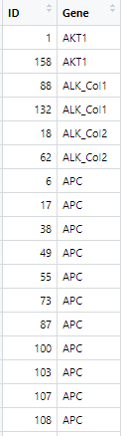
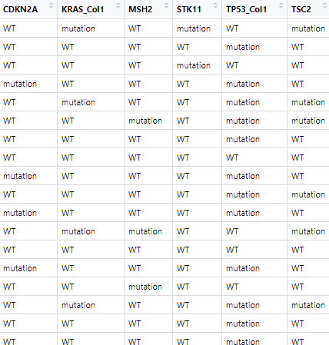
Data cleaning
Merged datasets by converting genomics file to wide format
Now both files have patients as rows, features as columns
I removed 10 patients followed up for < 12 months who were still alive at that time

Slide 3
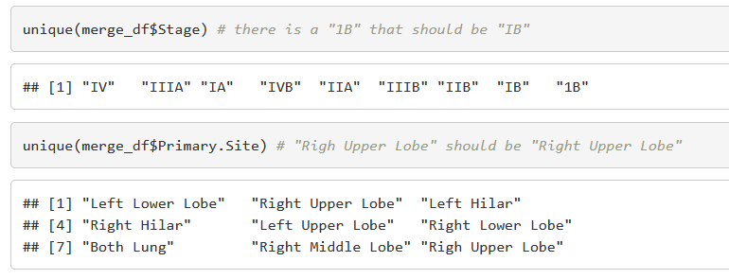
Data cleaning
Inspecting the data, a few typos were found
These were corrected, and all features were appropriately set to numeric values or categorical (factor) variables)

Slide 4
Feature adjustment
A new variable needed to be created to indicate whether the patient was alive at one year
New variables were added for total # metastases (N+M) and total tumors (N+M+Num.Primaries)
To reduce feature number, genes were omitted if there were not mutations in at least 10% of participants, as unlikely to have sufficient statistical power in those cases

Slide 5
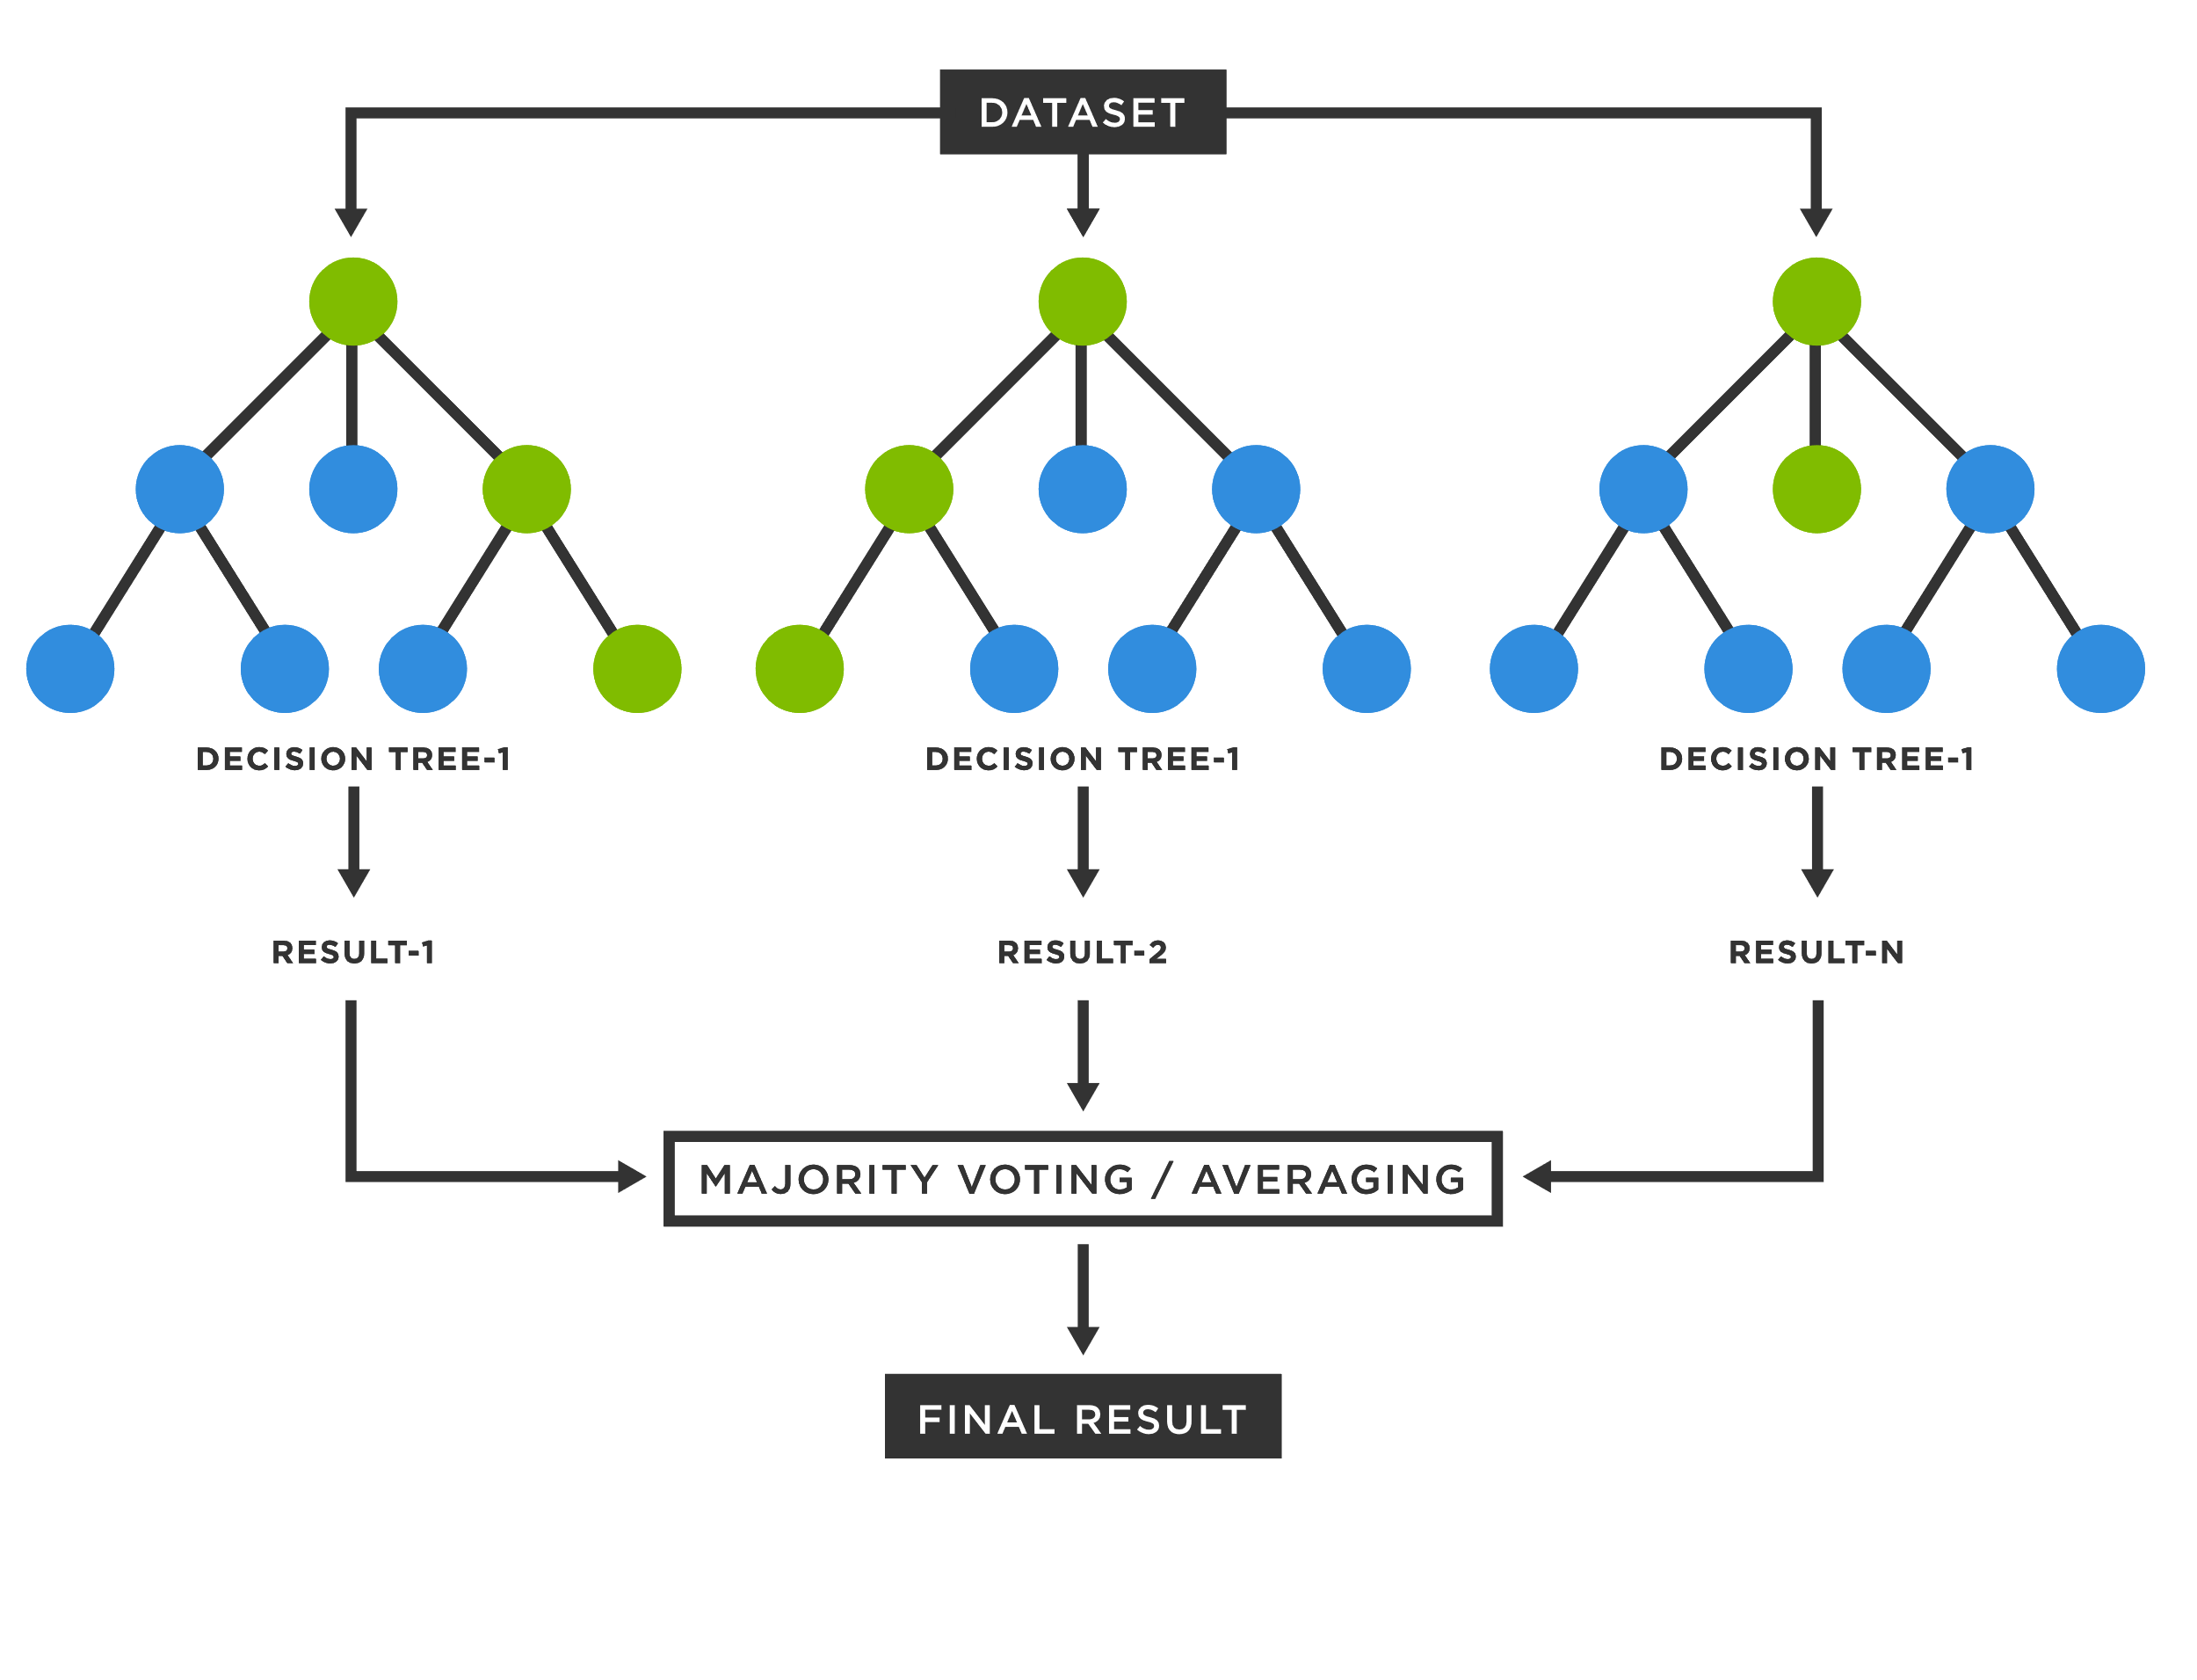
Algorithm choice: random forest
Since this is a simple classification problem, a random forest model seemed like a good choice
Machine learning approach
Handles the data in a more holistic way than some alternatives
Works well with both numeric and categorical data

Slide 6
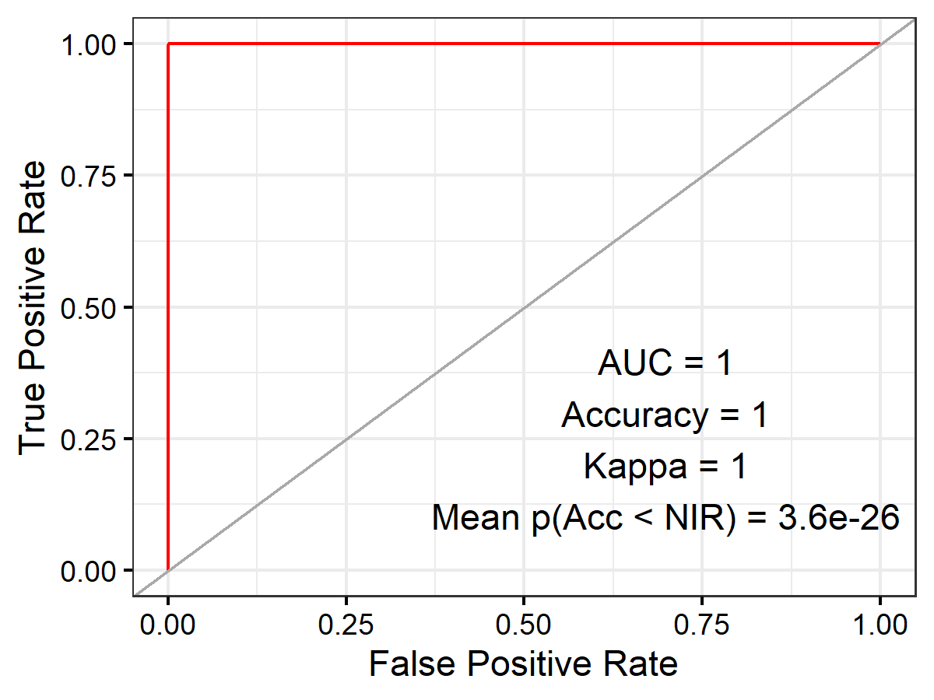
Assessing the model
Concerningly good performance
Model had 100% accuracy
This may be an instance of overfitting
(Although, leave-one-out cross-validation method used is designed to somewhat guard against this)

Slide 7
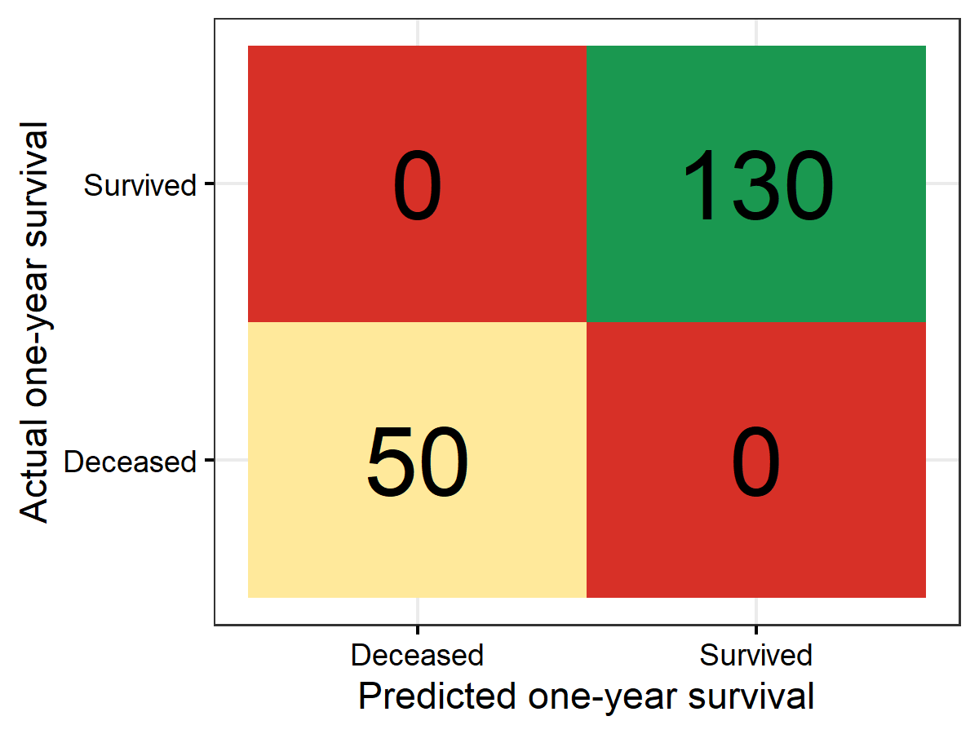
Assessing the model
More interpretable assessment: confusion matrix
All 130 survivors were correctly classified
All 50 deceased patients were also correctly classified

Slide 8
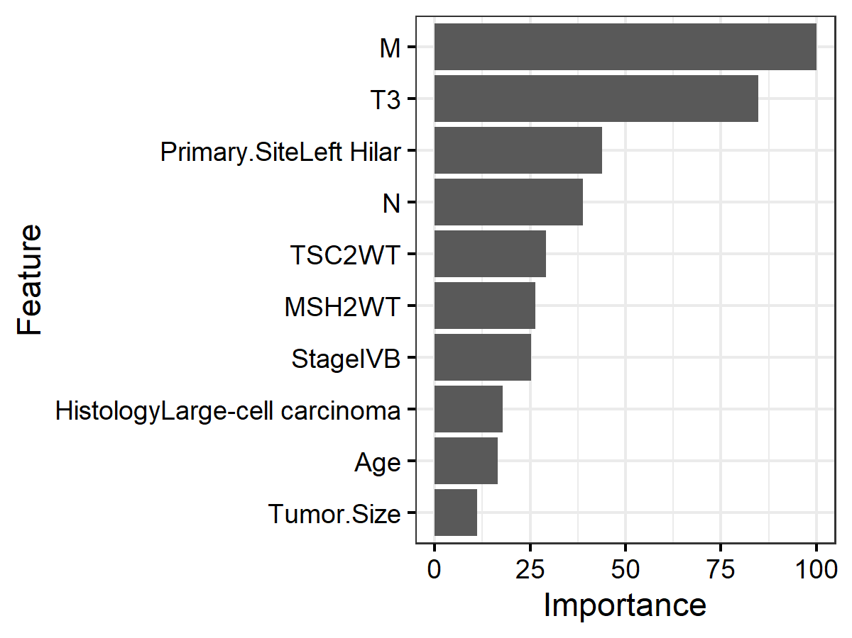
Top 10 most predictive features

Slide 9
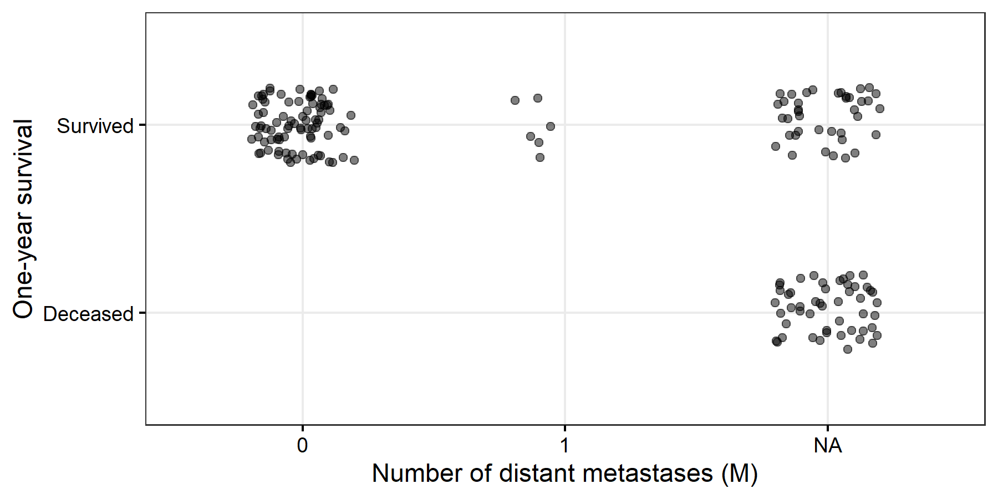
Top feature: Number of distant metastases (M)
This feature may not have been very predictive on its own
No value in comparing 0 vs. 1
And there is a lot of missing data
Still, if a patient had 0 distant metastases, chances are good that they survived
This is one (important) node in the decision tree
(Each dot is one participant)

Slide 10
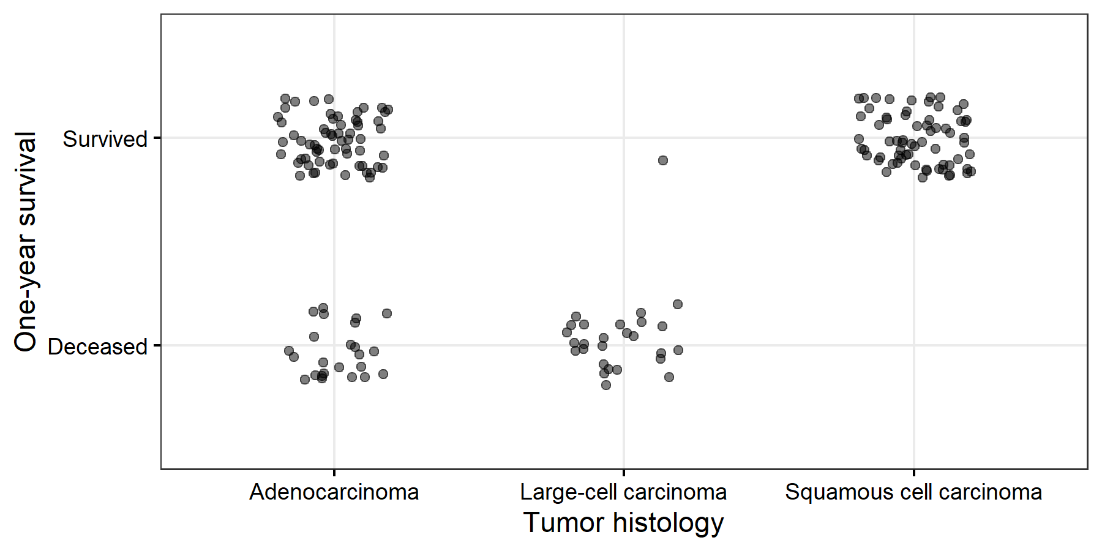
Other features are more easily interpretable
For example: Patients with large-cell carcinoma were less likely to survive at the one-year mark
Squamous cell patients more inclined to survival; adenocarcinoma is intermediate

Slide 11
Next steps
Run 100 iterations of model to more rigorously assess performance
Verify model performance with 80/20 split, withholding 20% of the data to use as a test set, and iterate over different splits
Build regression model to predict total survival time
Increase sample size with more data :)
Mine available public databases

